Slide 1
Longer Lives, Later Retirement?
Evidence from Around the World
Courtney Coile
Wellesley College and NBER
National Transfer Accounts Project 13th Global Meeting
August 3, 2020

Slide 2
Rising LE at Age 50 in All Country Income Groups
Source: https://population.un.org/wpp/DataQuery/

Slide 3
Rising LE at Age 50 in All Country Income Groups
Source: https://population.un.org/wpp/DataQuery/

Slide 4
Rising LFP For Women in Higher Country Income Groups
Source: https://ilostat.ilo.org/data/

Slide 5
Rising LFP For Women in Higher Country Income Groups
Source: https://ilostat.ilo.org/data/

Slide 6
Rising LFP For Women in Higher Country Income Groups
Source: https://ilostat.ilo.org/data/

Slide 7
Rising LFP For Women in Higher Country Income Groups
Source: https://ilostat.ilo.org/data/

Slide 8
No Trend Towards Rising LFP for Men Age 50-54
Source: https://ilostat.ilo.org/data/

Slide 9
Rising LFP For Men in High-Income Countries Only
Source: https://ilostat.ilo.org/data/

Slide 10
Rising LFP For Men in High-Income Countries Only
Source: https://ilostat.ilo.org/data/

Slide 11
Rising LFP For Men in High-Income Countries Only
Source: https://ilostat.ilo.org/data/

Slide 12
The Facts
Living longer all around the world
  LE at age 50 has risen by 9 years over past 70 years, 3-4 years over past 30 years
  Increases in countries of all income levels, larger gains in higher-income countries
Working longer only in richer countries
  Women in high-income countries: +17-25% points at ages 50-64
  Women in upper-middle-income: + 10% points at 55-64
  Men in high-income countries: +15% points at 60-64

Slide 13
The Questions
Does economic theory predict people will work longer as life expectancy increases?
Why are people working longer in richer countries (and might trend spread to other countries)?
What are the implications of living longer while not working longer?

Slide 14
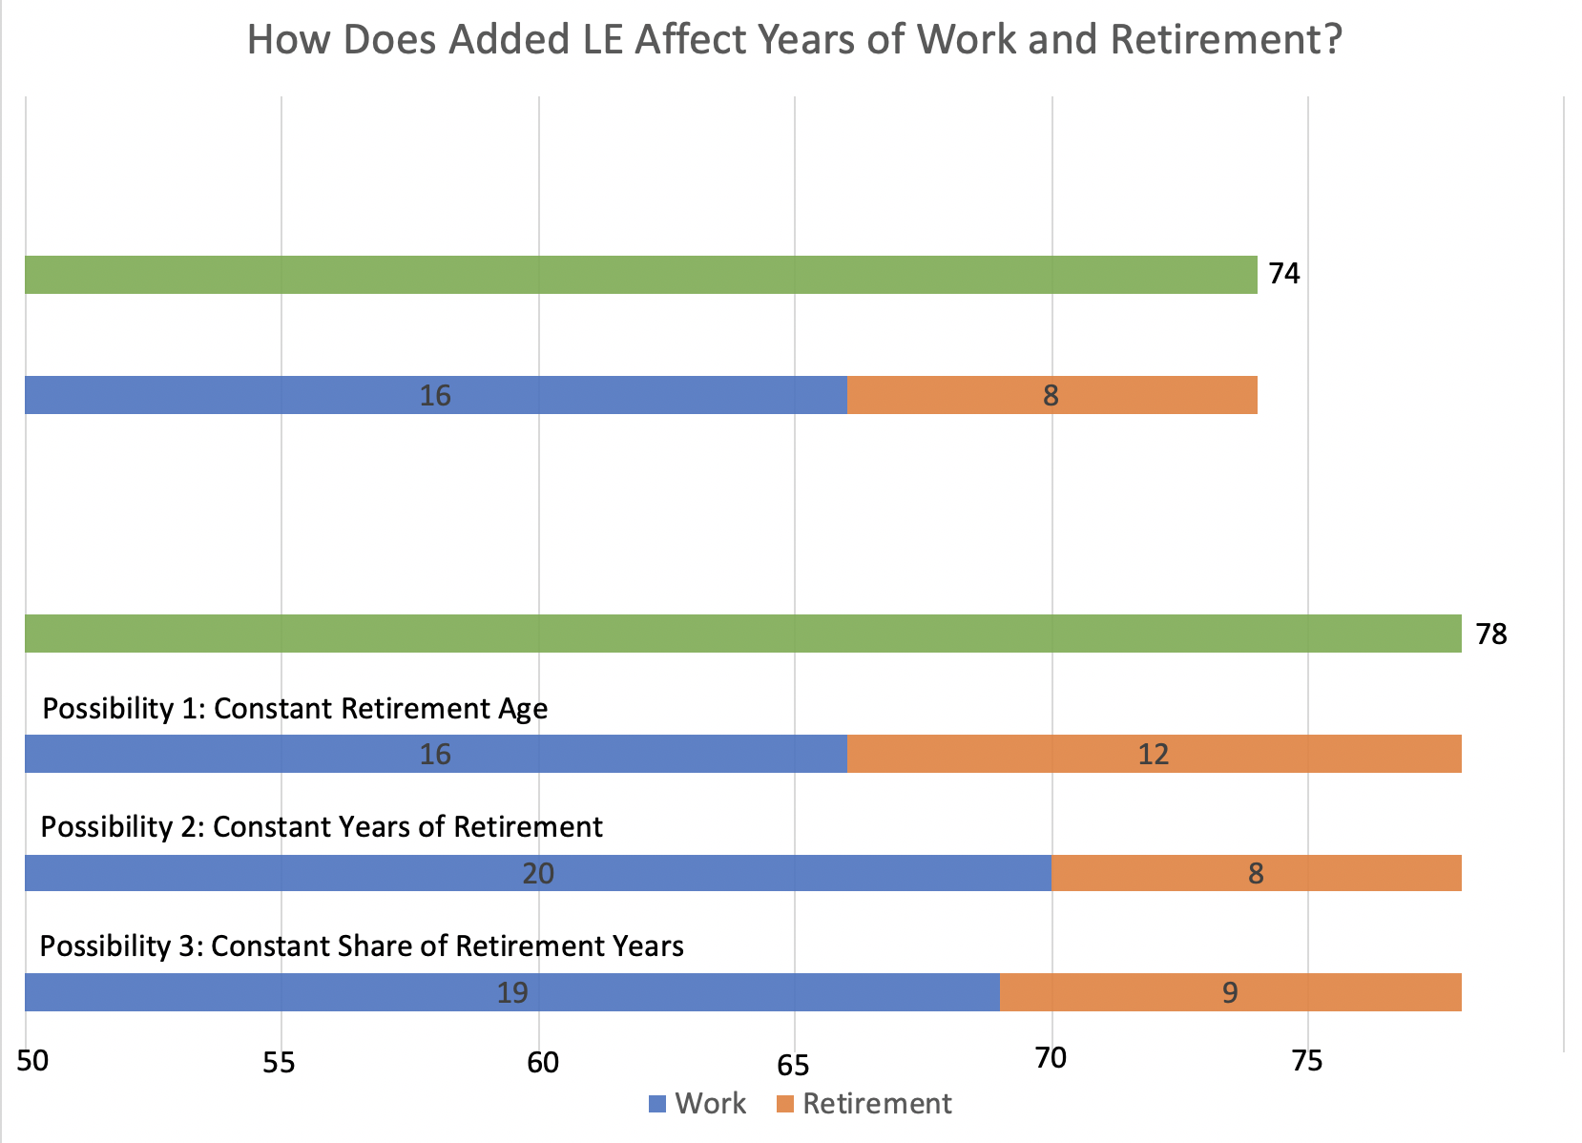
How LE Increases Affect Retirement: Example
Work and Retirement in 1990
Work and Retirement in 2020

Slide 15
How LE Increases Affect Retirement: Theory
Horizon effect: more resources needed to finance longer lifespan
  later retirement, at least in some cases (Chang, 1991)
Uncertainty effect: decrease in variability of age at death makes it optimal to save, plan for retirement
  earlier retirement (Kalemli-Ozcan and Weil, 2010)
Income effect: compression of morbidity
  later retirement and less than proportional increase in working life (Bloom, Canning, and Moore, 2007, 2014)
Return to schooling: rising LE affects both education (Ben-Porath, 1967) and retirement
  earlier retirement (Hazan, 2009; Hansen and Lonstrup, 2012)

Slide 16
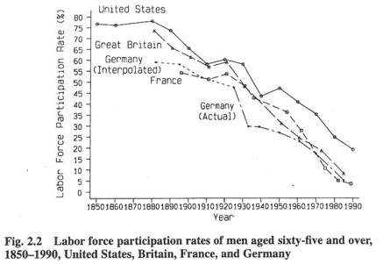
Earlier Retirement in Richer Countries in 20th Century
Source: Costa, 1998

Slide 17
Trend of Later Retirement Began in Mid-1990s (Men)
Employment Rates of Men Ages 60-64, ISS Countries, 1980-2016
Source: Borsch-Supan and Coile, 2018

Slide 18
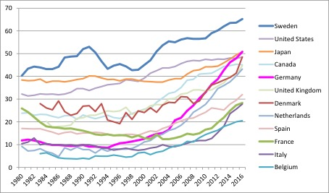
Trend of Later Retirement Began in Mid-1990s (Women)
Employment Rates of Women Ages 60-64, ISS Countries, 1980-2016
Source: Borsch-Supan and Coile, 2018

Slide 19
What Might Explain Trends in LFP in Richer Countries?
Explanations for earlier retirement (1900-1990s)
  Rising income
  Changes in production technology (Graebner, 1980; Moen, 1988)
  Growth of public pensions (Costa, 1998; Fetter and Lockwood, 2018; Gelber et al., 2017)
Explanations for later retirement (1990s-present)
  Rising education
  Improving health
  Cohort effects for women (Goldin and Katz, 2018); also affect husbands (Schirle, 2008)
  Pension reforms
Consider some evidence from NBER International Social Security (ISS) project

Slide 20
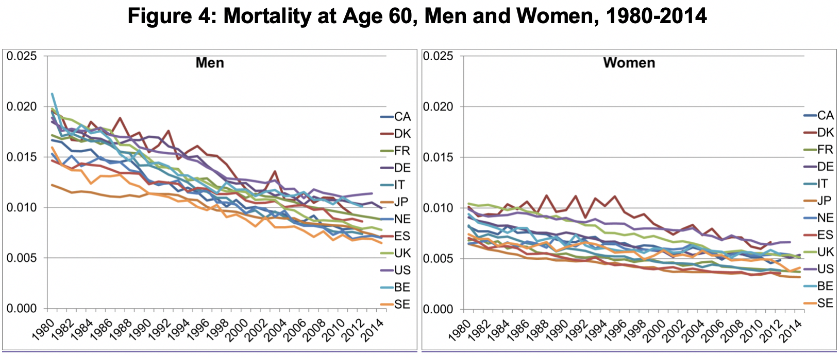
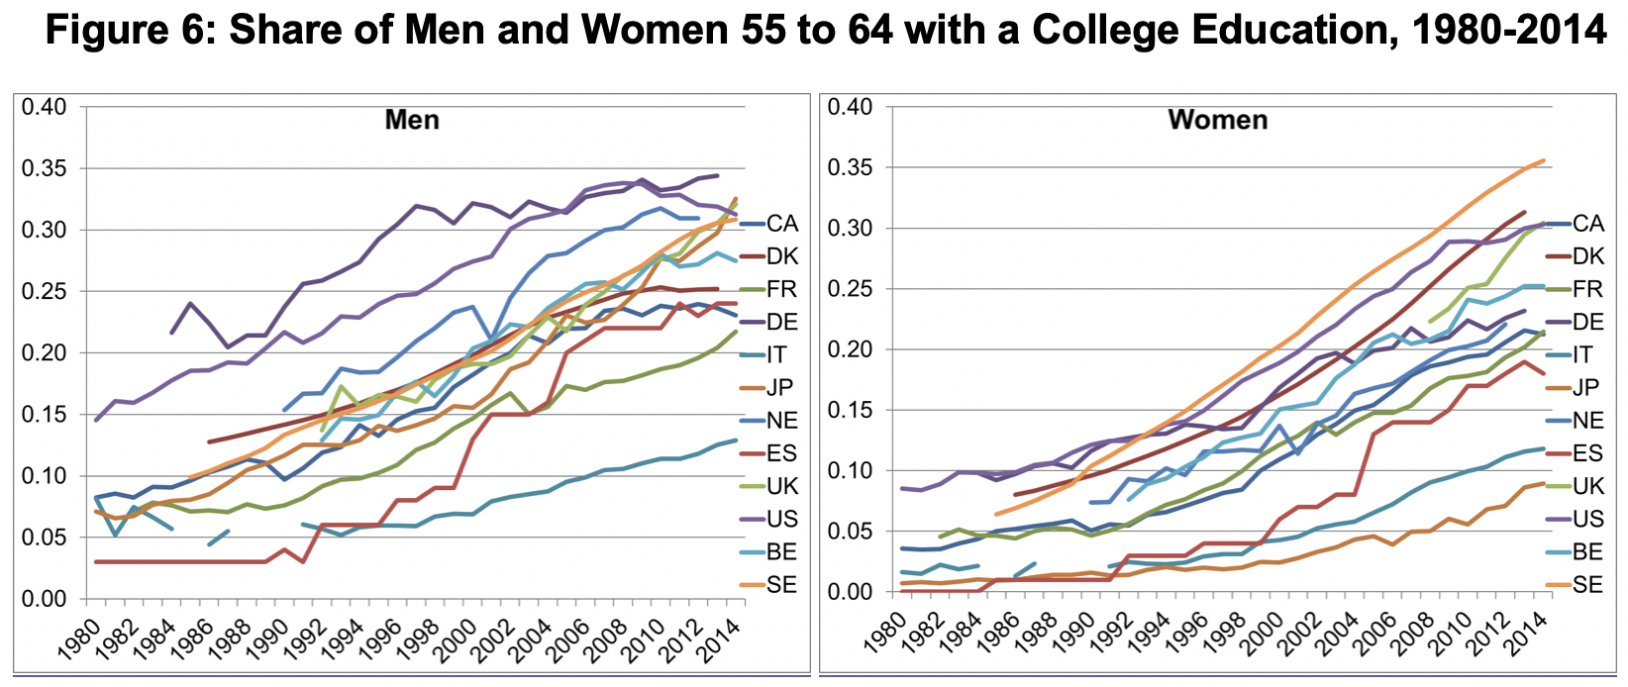
Trends in Health & Education (No U-Shape)
Source: Coile, Milligan, and Wise, 2020

Slide 21
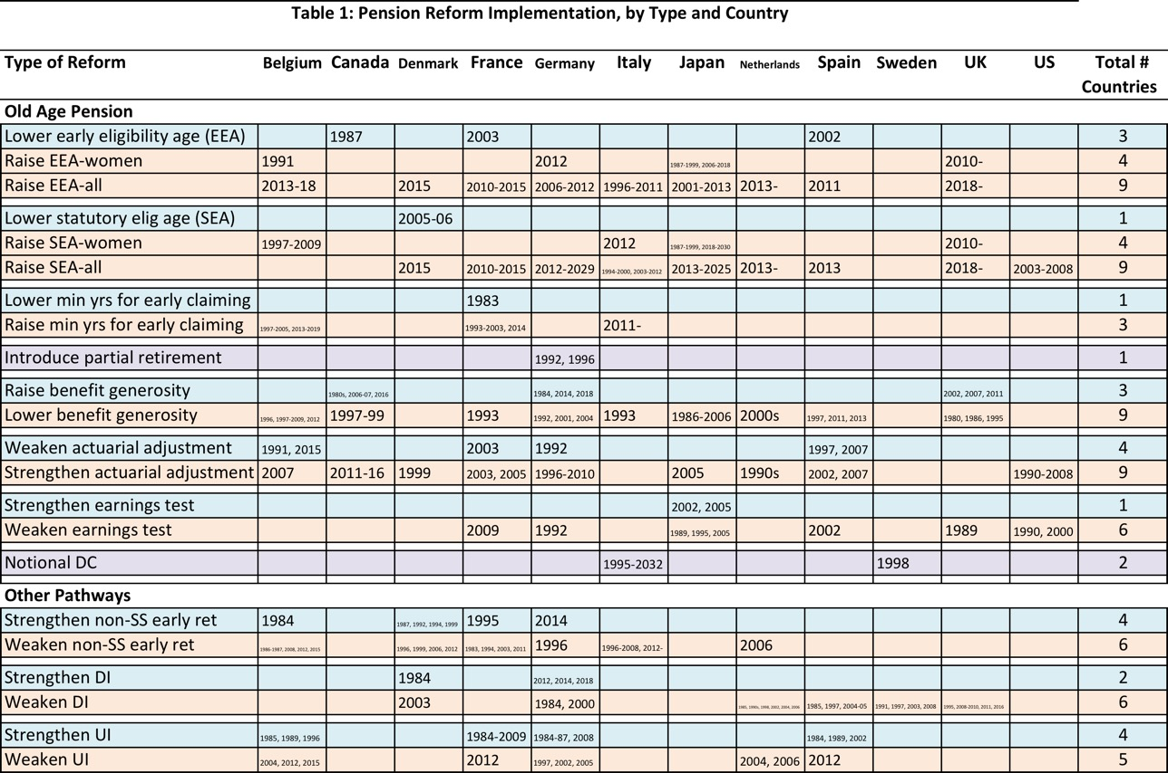
Pension Reforms: Frequent, Strengthen Work Incentives
Source: Borsch-Supan and Coile, 2018

Slide 22
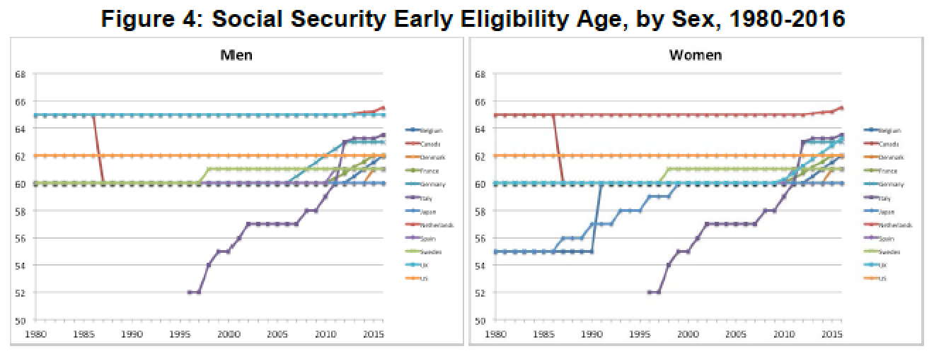
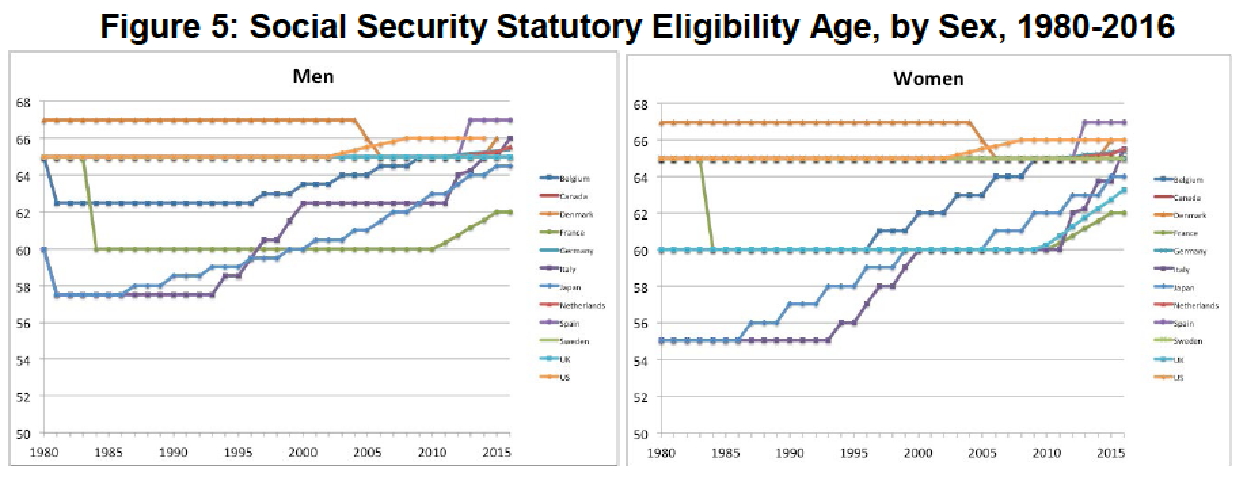
Rising Pension Eligibility Ages
Source: Borsch-Supan and Coile, 2018

Slide 23
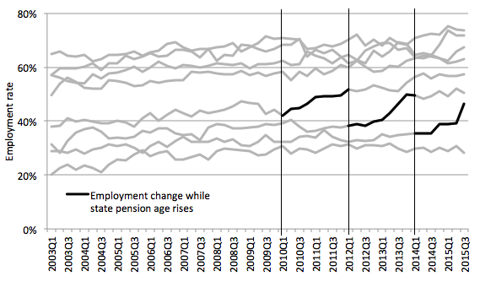
Higher EEA Leads to Later Retirement (UK Case Study)
Employment rates at specific ages (e.g., age 60)
UK women: Each time state pension age rises by one year, the employment rate jumps by 10 % points at the affected age
Similar evidence from Italy and Japan
Source: Coile, Milligan, and Wise, 2020 (UK Chapter)

Slide 24
Average Implicit Tax is Falling Over Time (Men)
Source: Borsch-Supan and Coile, 2018

Slide 25
Average Implicit Tax is Falling Over Time (Women)
Source: Borsch-Supan and Coile, 2018

Slide 26
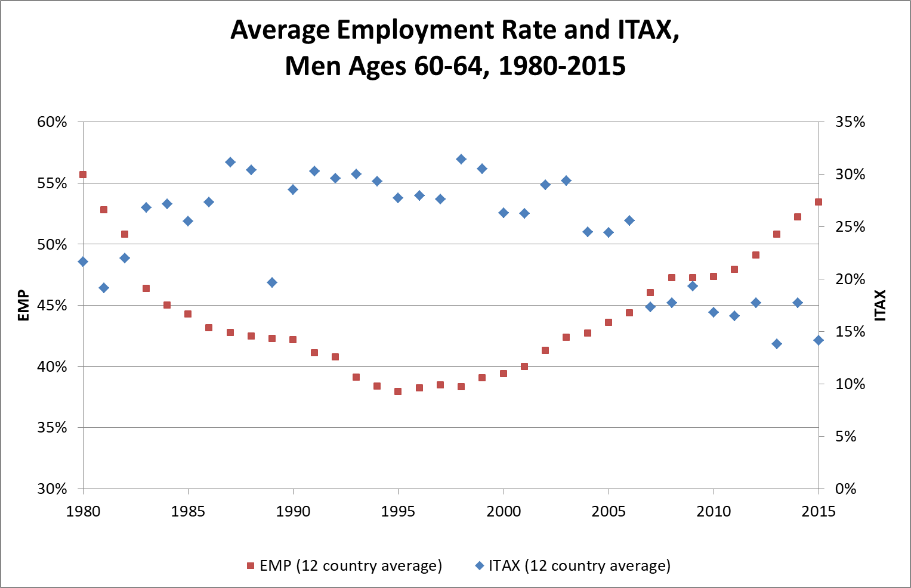
Trends in Implicit Tax and Employment (U-Shape)
Source: Borsch-Supan and Coile, 2018

Slide 27
Will Working Longer Trend Spread?
Big contributors to recent increase in LFP at older ages in high- & upper-middle-income countries:
  cohort changes in women’s LFP
  pension reforms
Might we expect these same factors to affect LFP in other countries?

Slide 28
No Surge in Female LFP in Poorer Countries
Source: https://ilostat.ilo.org/data/

Slide 29
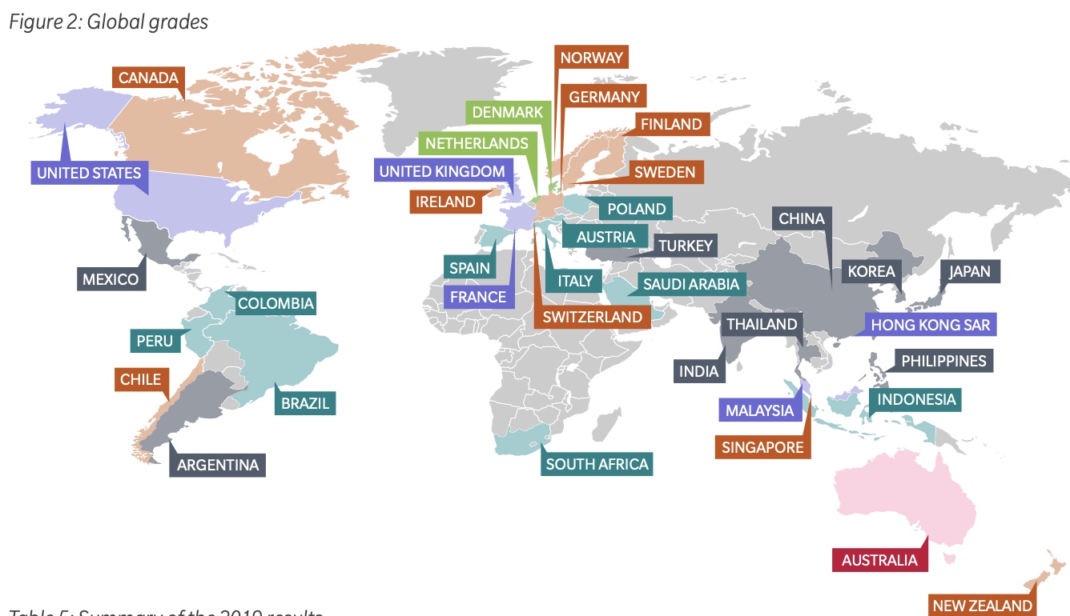

While Pension Reforms May Be Needed in Many Countries…
Source: Melbourne Mercer Global Pension Index, 2019; grades based on pension adequacy, sustainability, and integrity.

Slide 30
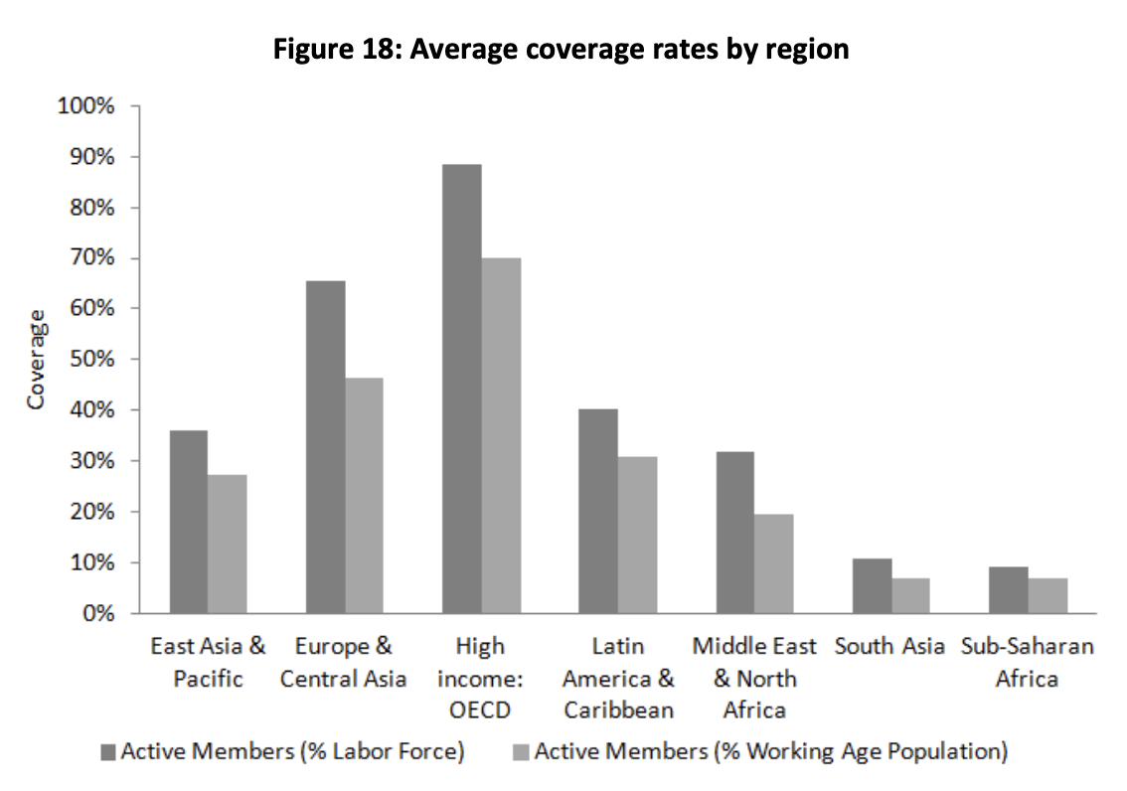
…They Will Not Affect a Majority of the Workforce
Source: World Bank Social Protection & Labor Discussion Paper No. 1211, 2012

Slide 31
Living Longer But Not Working Longer
Extra years of LE = extra years of retirement in lower/lower-middle-income countries
Options for financing old-age consumption
  Self: labor earnings, savings
  Family: multi-generational households, transfers
  Employer: pensions
  Government: public pensions, safety net programs
Which source will finance extra retirement years?
  Family? Strained by lower fertility rates
  Employer? Only if strong formal sector & tradition
  Government? Share of GDP on pensions <3% in all regions except Europe/OECD, but many competing priorities

Slide 32
Thank you!

Slide 33
References
Ben-Porath, Y. (1967). The production of human capital and the life cycle of earnings. Journal of political economy, 75(4, Part 1), 352-365.
Bloom, D. E., Canning, D., & Moore, M. (2014). Optimal retirement with increasing longevity. The Scandinavian journal of economics, 116(3), 838-858.
Bloom, D. E., Canning, D., & Moore, M. (2007). A theory of retirement (No. w13630). National Bureau of Economic Research.
Börsch-Supan, A. H., & Coile, C. (2018). Social security programs and retirement around the world: Reforms and retirement incentives–introduction and summary (No. w25280). National Bureau of Economic Research.
Chang, F. R. (1991). Uncertain lifetimes, retirement and economic welfare. Economica, 215-232.
Coile, C., K. Milligan, and D. Wise (2020). Social security programs and retirement around the world: Working Longer. University of Chicago Press.
Costa, D. L. (1998). The evolution of retirement. In The Evolution of Retirement: An American Economic History, 1880-1990 (pp. 6-31). University of Chicago Press.
Fetter, D. K., & Lockwood, L. M. (2018). Government old-age support and labor supply: Evidence from the old age assistance program. American Economic Review, 108(8), 2174-2211.
Gelber, A. M., Isen, A., & Song, J. (2017). The Effect of Pension Income on Elderly Earnings: Evidence from Social Security.
Goldin, C., & Katz, L. F. (2018). Women Working Longer (p. 11). University of Chicago Press.
Graebner, W. (1980). A History of Retirement: the Meaning and Function of An American Institution, 1885–1978. New Haven, Yale University Press.
Hansen, C. W., & Lønstrup, L. (2012). Can higher life expectancy induce more schooling and earlier retirement?. Journal of Population Economics, 25(4), 1249-1264.
Hazan, M. (2009). Longevity and lifetime labor supply: Evidence and implications. Econometrica, 77(6), 1829-1863.
Kalemli-Ozcan, S., & Weil, D. N. (2010). Mortality change, the uncertainty effect, and retirement. Journal of Economic Growth, 15(1), 65-91.
Lau, S. H. P., & Sánchez-Romero, M. (2012). Mortality transition and differential incentives for early retirement. Journal of Economic Theory, 147(1), 261-283.
Moen, J. R. (1988). Past And Current Trends In Retirement: American Men From 18. Economic Review-Federal Reserve Bank of Atlanta, 73(4), 16.
Schirle, T. (2008). Why have the labor force participation rates of older men increased since the mid-1990s?. Journal of labor economics, 26(4), 549-594.

